Slide 1



Welcome to our session
Congenital Syphilis in Arizona:
Best Practices for Prevention & Treatment
Notes:
Congenital Syphilis in Arizona: Best Practices for Prevention and Treatment

Slide 2
Session Speakers
Rebecca Scranton, MPH
Deputy Bureau Chief, Infectious Disease and Services
Arizona Department of Health Services
Rachel Gordon, MSN, RN, FNP-C
Clinician, Pima County Health Department

Slide 3
Financial Disclosure
All Planners and speakers/presenters of the training about to take place have no relevant financial relationship to disclose.
Arizona Alliance for Community Health Centers is accredited by the Arizona Medical Association to provide continuing medical education for physicians.
The Arizona Alliance for Community Health Centers Designates the Arizona Community Grand Rounds – Congenital Syphilis in Arizona: Best Practices for Prevention & Treatment educational activity for a maximum of 1 AMA PRA Category 1 Credits.

Slide 4
Congenital Syphilis Prevention
April 2, 2025
Rebecca Scranton
ADHS Deputy Bureau Chief, Bureau of Infectious Disease and Services

Slide 5
Objectives:
Understand syphilis trends & current statewide screening recommendations
Describe best practices for implementing screening in ED settings
Identify resources to support testing and treatment recommendations

Slide 6
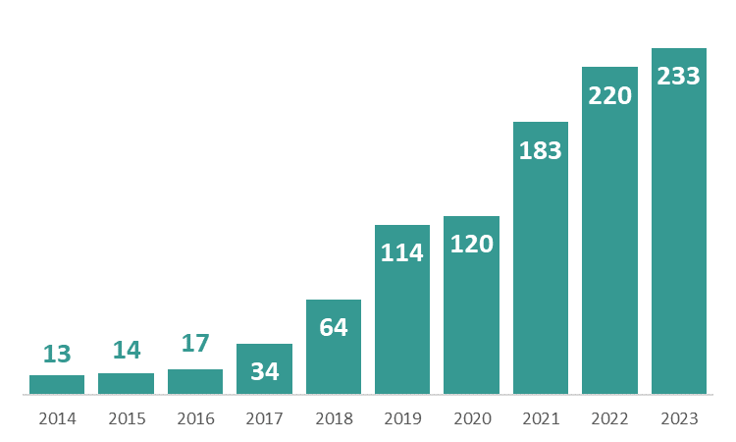
Arizona Congenital Syphilis Cases
are on the rise

Slide 7
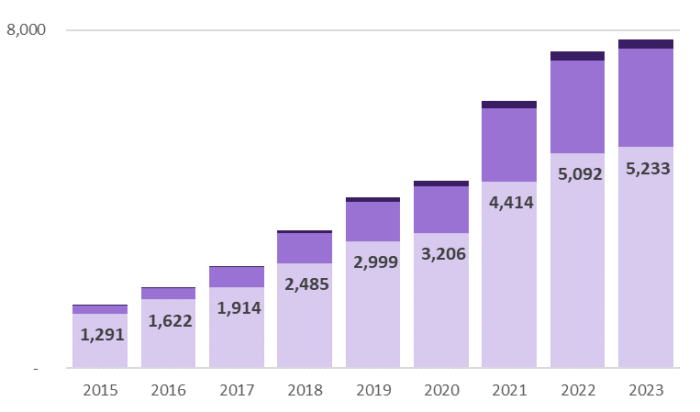
Less than 3% of AZ syphilis cases are in babies.
Congenital | Female 15-44 | All other cases

Slide 8
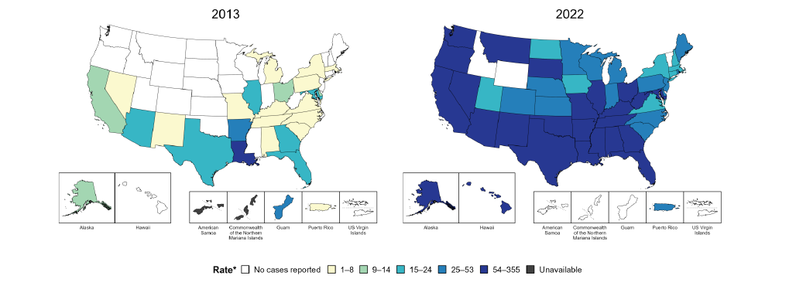
Rates of Congenital Syphilis Across the US

Slide 9
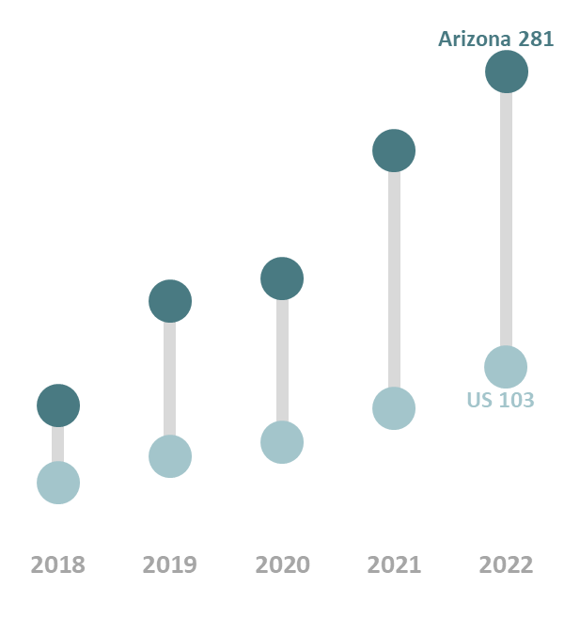
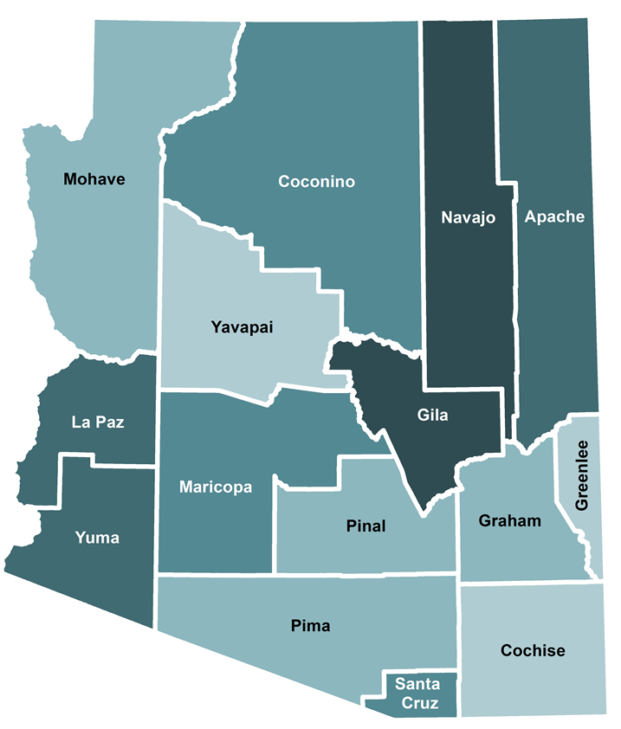
Arizona Congenital Syphilis
Arizona has consistently had a higher incidence of congenital syphilis than the United States.
Gila and Navajo counties reported the highest rates of congenital syphilis in 2022.
Notes:
Notes:
-Rates are calculated per 100,000 births.
-Map: darker color indicates higher rate.

Slide 10
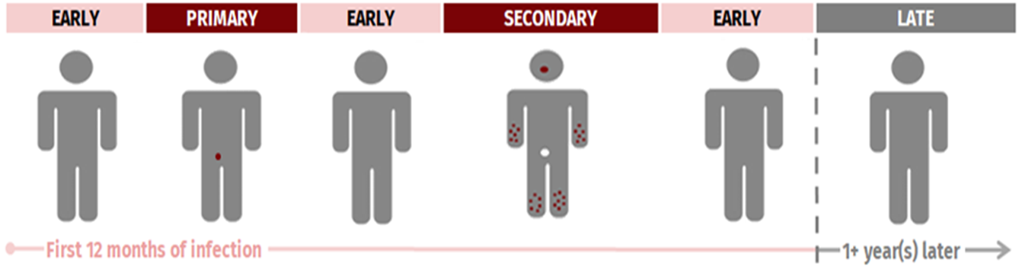
Screening is important for syphilis prevention.

Slide 11
Arizona Statutes and Administrative Code
Syphilis testing at first prenatal examination, after a diagnosis of pregnancy (ARS § 36-693)
“Prenatal care providers in Maricopa County are required to screen for syphilis at the first prenatal care visit, once during the third trimester, and again at delivery.” (2003)
Additional syphilis testing at 28 to 32 weeks gestation and at delivery (A.A.C. R9-6-381) (2018)

Slide 12
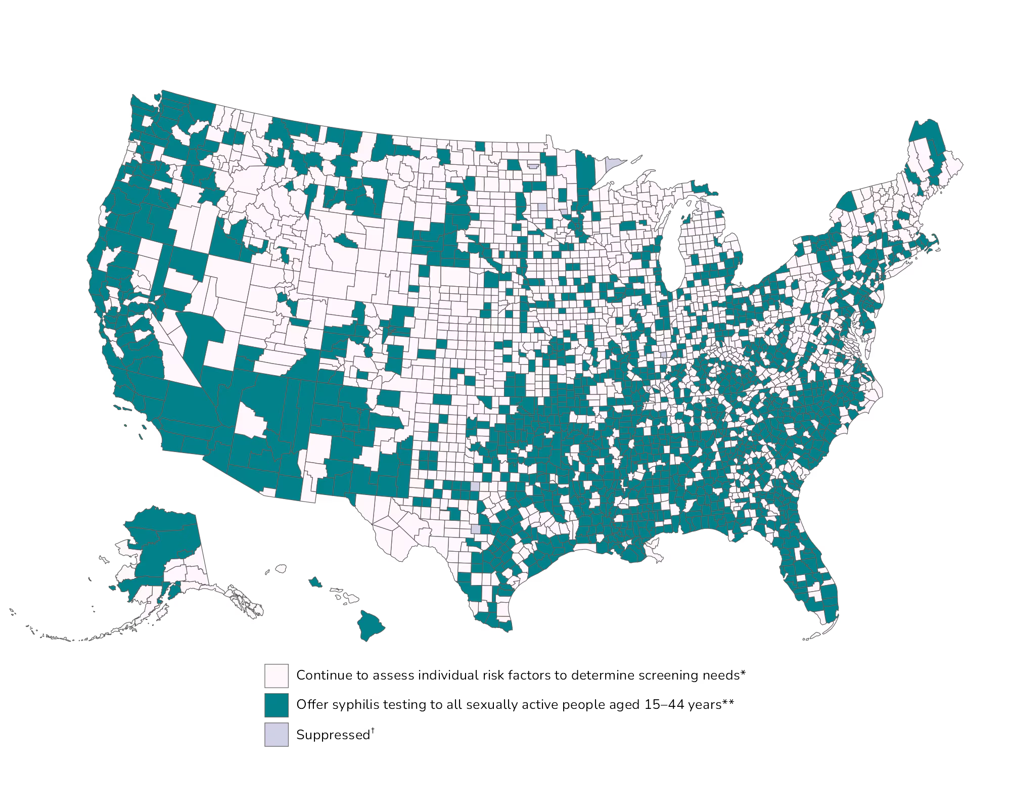
CDC Recommendation: Test all people 15-44.
in areas with a PS rate in females 15-44 (F15-44)
> 4.6 per 100,000.
The AZ F15-44 rate is
26 per 100,000.

Slide 13
Maternal Vulnerability Factors
52% used substances (2018 - 2023 data)
  38% Non-heroin opioid use (2023)
  35% Meth (2023)
38% had no/late prenatal care
  31% of delivering patients with syphilis and no prenatal care in Arizona, had at least one ED visit during pregnancy
21% unstably housed (2023)

Slide 14
Updated 2024 Arizona Syphilis Screening Guidelines
Screen sexually active individuals aged 15-44 Annually for syphilis
Implement syphilis opt-out screening for in ED/UC for pregnant and 15-44 unknown pregnant
  In settings where follow-up is uncertain, point of care test plus same day tx prior to discharge

Slide 15
Operationalizing Opt Out testing
Inform (verbally/written)
  “Due to the current high rates of syphilis and congenital syphilis in Arizona, we currently offer syphilis testing as part of our routine services - do you have any questions about this service?”
Patients have the right to refuse service

Slide 16
Additional Screening Settings
Correctional facilities
Settings that serve people with addiction/Substance Use Disorder.

Slide 17
How?

Slide 18
AHCCCS:
“Healthcare Providers shall ensure that members are tested for syphilis at least annually, beginning at age 15 years.”
October 1, 2024, AHCCCS Medical Policy Manual (AMPM)

Slide 19
New Differential Adjusted Payment (DAP)
DAP = Positive adjustment to the AHCCCS Fee-for-Service (FFS) rates
Key requirements for maternal syphilis DAP
  All females 15-44 presenting at hospital/ED shall be screened for syphilis
  If positive, must receive first dose of treatment prior to discharge
Where to find more info:
  Public Notice
  Policy Standards

Slide 20
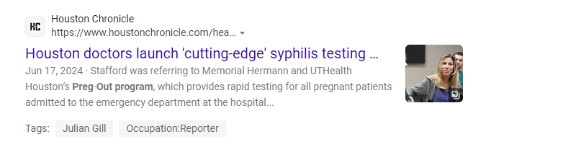
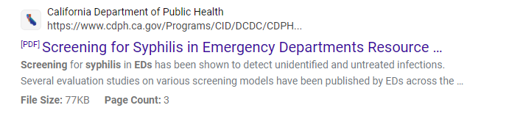
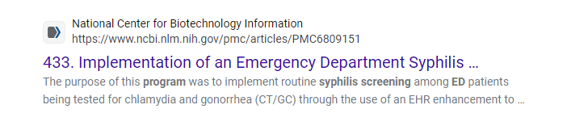
ER Testing models already exist!

Slide 21
Generate Buy-in
Identify a clinic champion
Include the people impacted (e.g. lab, pharmacy, finance, ED providers, IT, admin, etc.) in protocol development
Connect with other EDs
  Check out Fall 2023 IHS STI Treatment Guidelines

Slide 22
Establish Protocols and Workflows
Implement standing orders
Leverage syndemic (syph/HIV/HCV/pregnancy testing) opt out screening
Automate the test ordering process (e.g., EMR best practice alert)
Consider tests that reduce lab turnaround time (e.g., rapid, in house, etc.)
Educate staff on process (e.g., lectures/in-services, virtual learning, reminder emails, in-person training)
Ensure benzathine penicillin g availability & initiate treatment prior to release

Slide 23
EHR and Lab Bundles
Alert options
  Age driven alerts for 15+
  Diagnosis driven alerts (i.e. pregnancy)
  Chronic problem list
    Generate code for persons historically tx’d for syphilis, put RPR in the comments)
Custom lab bundle that can be ordered with one click in their EHR (Syphilis + HIV + Hep C)

Slide 24
POC Testing Options
Syphilis Health CheckTM
Chembio DPP®HIV-Syphilis
First to Know

Slide 25
Follow-up for Positives
Administer first dose prior to discharge
Options for follow-up:
  Schedule dose 2 and 3 OR
  County health department can coordinate follow-up doses
Public health follows-up on persons with reactive test results to ensure complete treatment

Slide 26
Objectives:
Trends: CS rates are increasing particularly for no/late prenatal care.
31% of maternal cases with no prenatal care, had at least 1 ED visit during pregnancy
ED test and treat models already exist

Slide 27
Questions?
Contact
  Program Contact: sti@azdhs.gov
  ADHS Data Request Submission Form
  ADHS STI Provider Line: 602-364-4571
Additional Resources
  Congenital Syphilis Outbreak
  ADHS - Sexually Transmitted Infection (STI) Control - STI Data & Reports
  ADHS STI Printable Resources for Providers and Local Health Jurisdictions

Slide 28

SPOTS
Syphilis Pregnancy/Partner
Onsite Treatment Support
January 2025
Rachel Gordon MSN, RN, FNP-C

Slide 29
Learning Objectives
By the end of this presentation, you will be able to:
Discuss Congenital Syphilis (CS) trends nationally and in Arizona
Review the current screening guidelines for syphilis in pregnant women and the general population
Identify barriers to effective screening and treatment of syphilis
Discuss innovative ways to deliver syphilis treatment to patients unwilling or unable to access the traditional healthcare system
Notes:
Do you want to see lower Congenital Syphilis (CS) rates in your jurisdiction?
The Pima County Health Department (PCHD) shares these goals and has developed an approach to prevent CS in Southern Arizona.
Introduction to PCHD’s SPOTS program, also known as the Syphilis Pregnancy/Partners Onsite Treatment Support program.

Slide 30

Syphilis in AZ
Arizona has consistently had a high CS case rate for the last several years.
2023 Arizona ranked 4th in the US for CS.
Reviews of CS cases have identified missed opportunities for screening that would have allowed earlier diagnosis and more timely treatment
Notes:
https://www.cdc.gov/mmwr/volumes/69/wr/mm6922a1.htm
the most commonly missed opportunities for prevention of congenital syphilis are a lack of adequate maternal treatment despite timely diagnoses of syphilis (31%) and a lack of timely prenatal care (28%), followed by late identification of seroconversions (11%)
implications for public health practice?
Halting continued increases in congenital syphilis requires addressing the missed prevention opportunities and implementing tailored interventions based on local experience.
In 2023, Arizona ranked 4th in the US for congenital syphilis rates, with 296.6 cases per 100,000 live births, following South Dakota, New Mexico, and Mississippi.

Slide 31
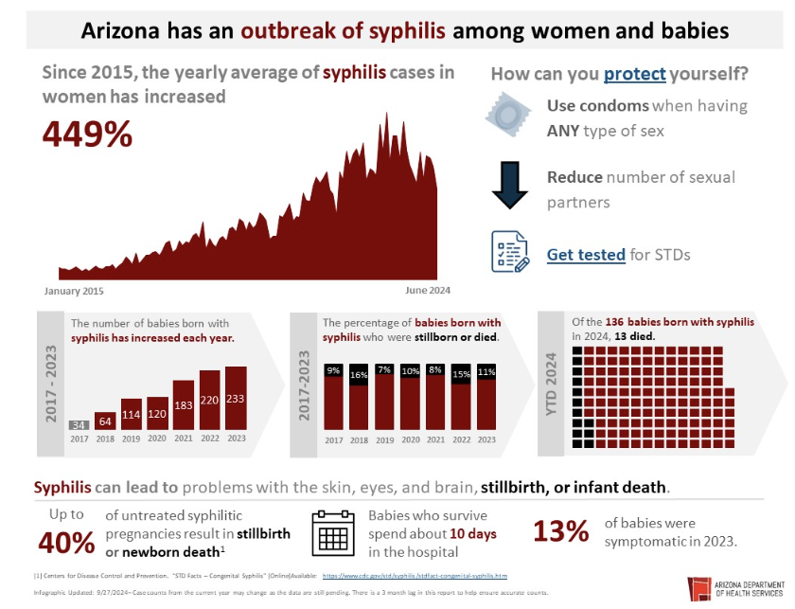

Slide 32
The Standard of Care
U.S. Preventive Services Task Force (USPSTF): Screen all pregnant women early for syphilis
American College of Obstetricians and Gynecologists (ACOG): Screen all pregnant women for syphilis three times
- At the first visit
- In the third trimester, and
- Again at delivery
Sounds easy right?
  Assuming all women can access prenatal care, and can afford prenatal care and labs
  But only ~75% of women establish care in first trimester.
  13% deliver with inadequate prenatal care, and 2% deliver with
  no prenatal care.

Slide 33
Barriers to Care
Missed Opportunities and Delayed Prenatal Care
Inadequate Prenatal Care = Missed Opportunities to Screen
• Inability to access prenatal care has been identified as the main reason for not being screened in a timely manner
• Common reasons: lack of transportation, inability to leave work during clinic hours, and childcare needs
Delayed Lab Results = Missed Opportunities to Treat
• Even if the diagnosis is made not all offices carry the treatment… and not all patients can return to the office for three injections one week apart
Notes:
Inadequate Prenatal Care = Missed Opportunities to Screen
Inability to access prenatal care has been identified as the main reason for not being screened in a timely manner
Common reasons: lack of transportation, inability to leave work during clinic hours, and childcare needs
Delayed Lab Results = Missed Opportunities to Treat
Even the diagnosis is made not all offices carry the treatment… and not all patients have the ability to return to the office for three injections one week apart
Missed opportunities to treat:
Barriers to Effective Treatment include:
Office access to Penicillin Benzathine (aka Bicillin)
Inadequate time to treat during pregnancy for syphilis (3 doses over three weeks for patients with unknown duration of infection)
Late term infection / reinfection of syphilis from untreated partners
Lack of prenatal care coordination for patients with financial, language barriers
Fear of accessing prenatal care (i.e. documentation status, ongoing substance use disorder, interpersonal violence, etc.)
Inability / hesitance to treat partners

Slide 34
Missed Opportunities to Treat
Barriers to Effective Treatment
Office access to Penicillin Benzathine (Bicillin)
Inadequate time to treat during pregnancy for syphilis (3 doses over three weeks for patients with unknown duration of infection)
Late term infection / reinfection of syphilis from untreated partners
Lack of prenatal care coordination for patients with financial, language barriers
Fear of accessing prenatal care (i.e. documentation status, ongoing substance use disorder, interpersonal violence, etc.)
Inability / hesitance to treat partners

Slide 35
SPOTS Program
Syphilis Pregnancy/Partner Onsite Treatment Support
Increasing access to treatment of syphilis for pregnant persons and their partner(s).
Especially patients who have been unwilling or unable to access syphilis treatment at a medical facility or at a Pima County Health Department clinic.
A team will make a scheduled home visit to treat
the patient and partner.

Slide 36
SPOTS Program
“No wrong door” to initiate a referral!
Referrals for pregnant persons and their partners can happen through:
  A community prenatal care provider
  PCHD clinic staff
  WIC counselor
  Perinatal case manager
Referred cases are:
  Evaluated using state STI records and history to determine clinical stage and treatment history
  Considered for in-home treatment in consultation with a dedicated nurse and clinician.
Partner treatment: Even if the pregnant person has been adequately treated, their partners are still eligible for the SPOTS program as contacts and can get tested and evaluated for treatment in the home.

Slide 37
Secondary Goals
Decrease transmission of the syphilis
Decrease syphilis morbidity and mortality rates
Increased awareness of syphilis among community members and medical providers
Facilitate improved syphilis test of cure monitoring using RPR titers
Notes:
Note, Title X outreach: Female postpartum BCM options offered to improved for family planning until 6 months RPR titers obtained to confirm syphilis treatment effective

Slide 38
SPOTS Workflow
Referral/Intake Process
Assess Inclusion/ Exclusion criteria
  No history of penicillin allergy
  Syphilis diagnosis/staging
  Cellphone service or working landline
  Patient lives in an area with 911 and EMS
Schedule home visit
  Assess safety and patient openness for home treatment
  Assess partner needs, review Prism data
  Document clinician order to treat patient (and partner in their separate record)
  Confirm appointment
  Go to patient home for treatment
Follow up
  Post visit EMR update
  Post Provider referral letter

Slide 39
SPOTS Team
Minimum of 2 personnel on the travel team
Clinician or RN, and an assistant (Medical Assistant or CHW)
  Both certified in Basic Life Support (BLS)
  Both trained to recognize and treat anaphylaxis
  Cell phone access to 911 is essential
Telehealth for clinician consultation can be helpful in the event the field team has a question

Slide 40
SPOTS Home Visit
Re-evaluate suitability and safety for home visit on arrival
Obtain verbal and written consent for patient and partner
Complete/confirm history, take vitals
Obtain any needed specimens - draw blood /collect swabs
Review treatment plan and administer medication
Observe for adverse reactions for a minimum 30 minutes
Provide patient education
Schedule follow up, and other links to care as needed

Slide 41
Post Visit
RN and clinician complete proper documentation in the EHR
If treatment was not completed, nurse documents reason for incomplete treatment status in the EHR
Post-referral letter completed and sent to referring clinician
Communicable Disease Report (CDR) updated
SPOTS clinician reviews treatment notes and updates referral
If unable to provide complete treatment, team continues efforts to establish a treatment plan with the patient

Slide 42
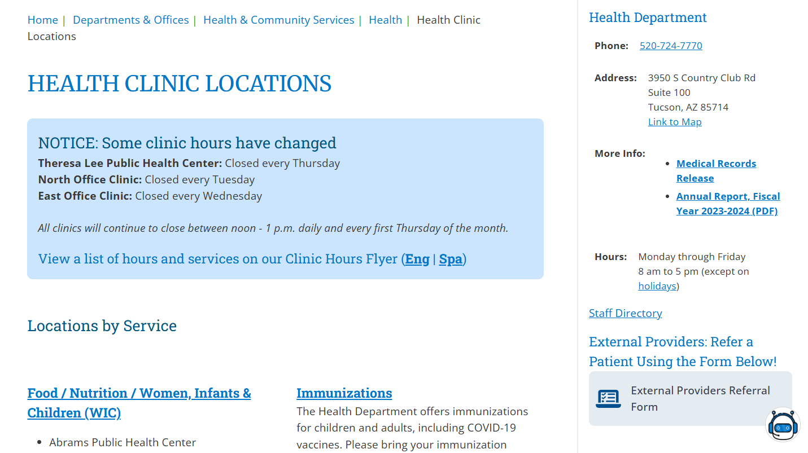
How to Refer Patients
EXTERNAL PROVIDERS REFERRAL FORM

Slide 43

SPOTS Referrals
Online referral page:
https://www.pima.gov/2345/Health-Clinic-Locations

Slide 44

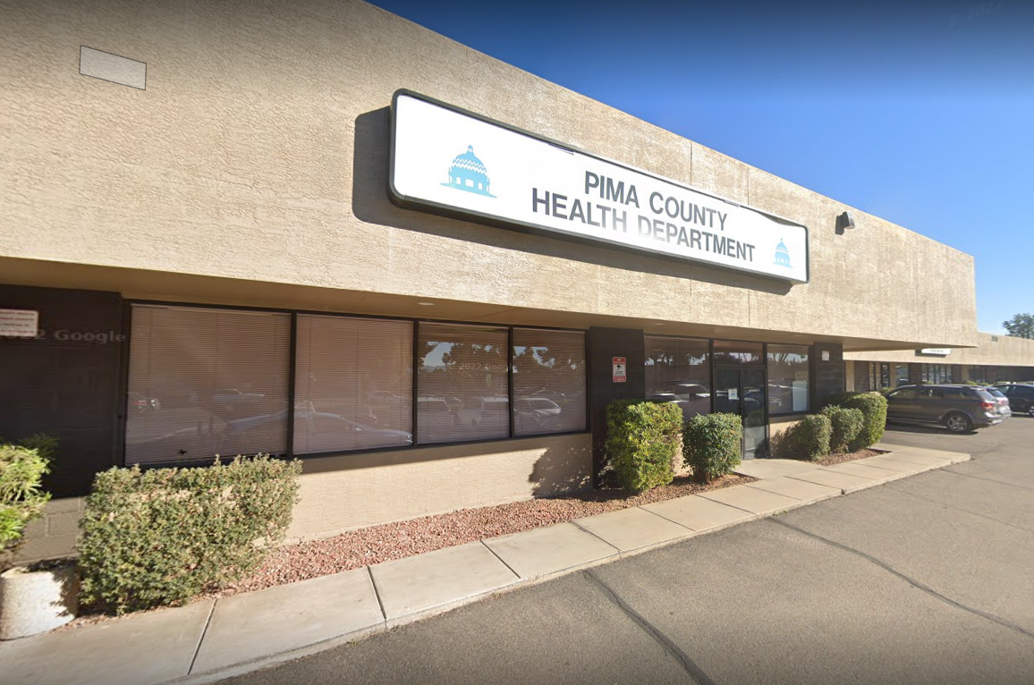
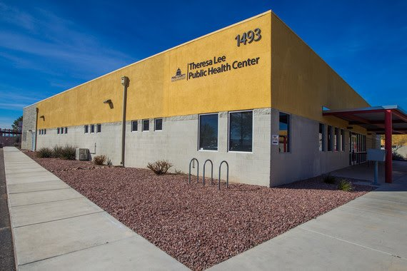
EXTERNAL PROVIDERS REFERRAL FORM

Slide 45
Questions?
Perinatal Nurse: (520) 724-5334
Rachel Gordon, MSN, RN, FNP-C
  520-724-5334
  Rachel.Gordon@Pima.gov

Slide 46

Thank you
Please complete this survey:
Coming up in May:
Mitigating Arizona’s Heat-related Health Risks

